Slide 1

Remote Patient Monitoring with
Tele-Medicine based on
Internet-of-Things

Slide 2
CONTENTS
Abstract
Introduction
Block diagram
Working
Flowchart
Schematic
Conclusion
Future scope

Slide 3
Abstract
Internet of Things (IoT) is a system in which connected physical objects can be accessed through the internet.
Using IoT technology, various smart objects can be connected via the internet and can provide efficient data exchange methods for application purposes.
Among the large range of applications that are based on IoT, smart healthcare services play a major role.
Such a system consists of networked sensors placed on the human body that collects information regarding the patient’s health status and alerts the physician immediately during an emergency.
The privacy of each patient’s data is also highly protected.

Slide 4
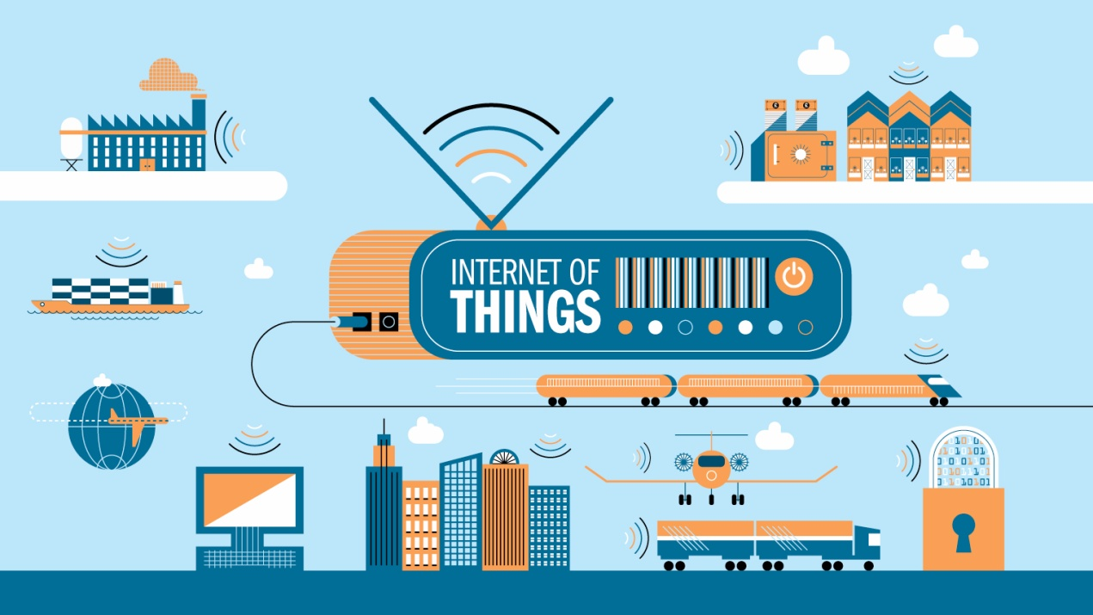
What is IoT ?
IoT is a combination of hardware and software technology that produces trillions of data by connecting multiple devices and sensors with cloud.
Anything can be IoT device, if it can transmit and receive data over the cloud and designed to process a unique task.

Slide 5
Use of Iot technology in
Medical field
IoT in healthcare is a heterogeneous computing, wirelessly communicating system of apps and devices.
It connects patients and health providers to diagnose, monitor, track and store vital statistics and medical information.
Few examples of IoT in Healthcare
Headsets that measure brainwaves.
BP monitors
Glucose monitors

Slide 6
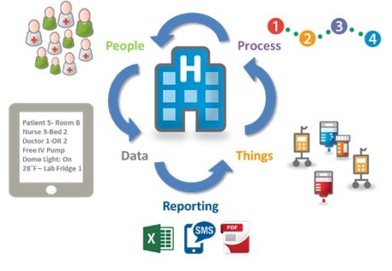
ECG monitors.
Pulse oximeter.
Sensors embedded in surgical robots and device implants.

Slide 7
Introduction
According to the constitutions of World Health Organization (WHO) the highest attainable standard of health is a fundamental right for an individual.
The immediate objective and outcome of this idea was to develop a more reliable remote patient monitoring system.
This system allows healthcare professionals to monitor their patients, who are either hospitalized or executing their normal daily life activities from anywhere in the world.
The GSM (Global System for Mobile) Technology and Cloud computing helps in the transfer and access of data between the patient and the medical professional .

Slide 8
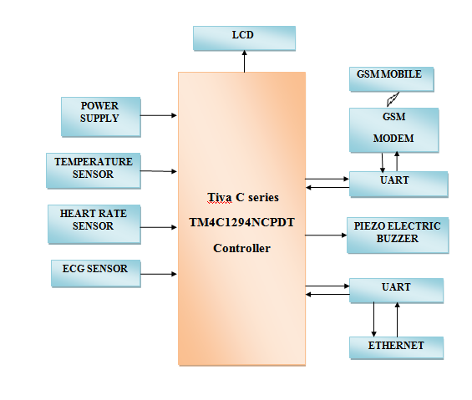
Block Diagram

Slide 9
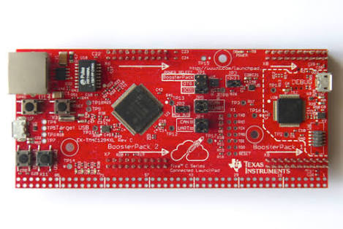
TM4C1294NCPDT Microcontroller
Features:
40-pin BoosterPack connector.
USB port for power and debugging.
External debug connection.
USB micro connector.
Ethernet port
32-bit ARM Cortex-M4F architecture.
120-MHz operation.
High-performance interrupt handling.
Memory protection unit (MPU) to provide a privileged mode for protected OS functionality.

Slide 10
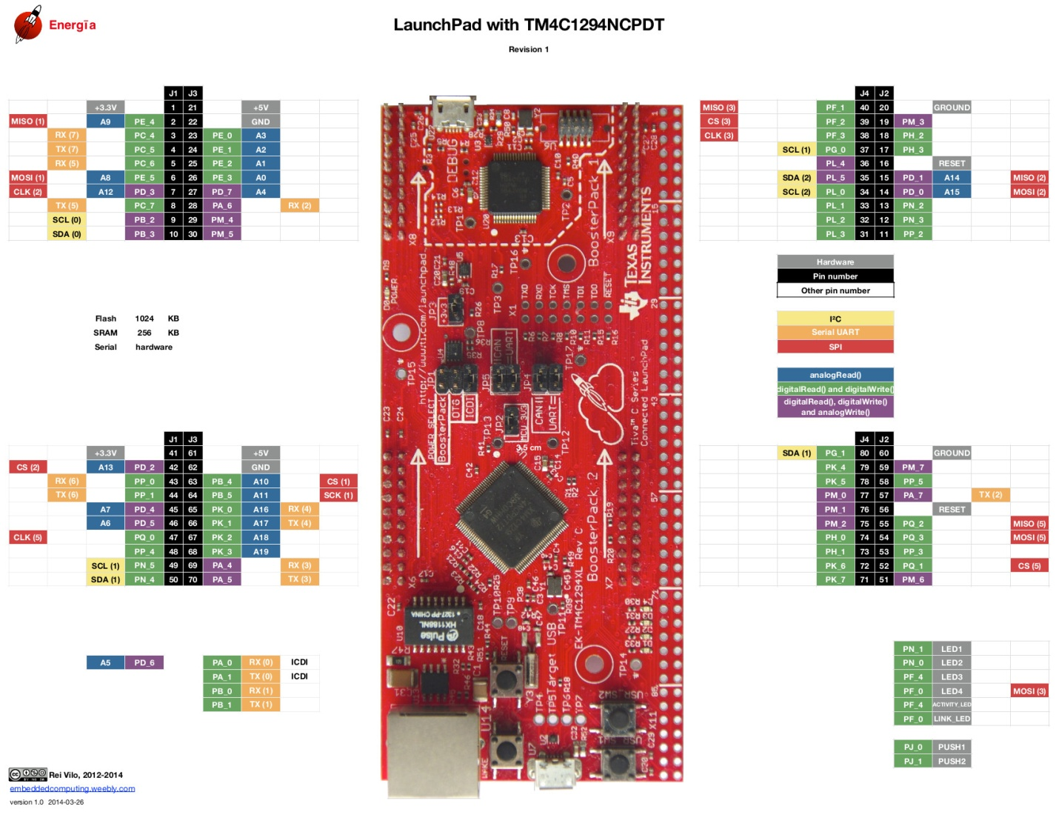
PIN out diagram

Slide 11
Temperature sensor (LM35)
The LM35 series are precision integrated-circuit temperature devices with an output voltage linearly proportional to the Centigrade temperature.
The LM35 device does not require any external calibration or trimming to provide typical accuracies of ±¼°C at room temperature.
The low-output impedance, linear output, and precise inherent calibration of the LM35 device makes interfacing to readout easy.
The LM35 device is rated to operate over a −55°C to 150°C temperature range.
The LM35-series devices are available packaged in hermetic to transistor packages.

Slide 12
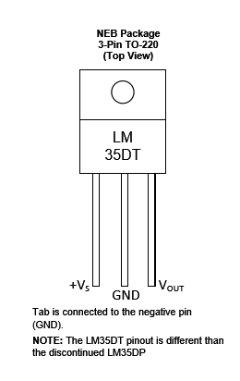
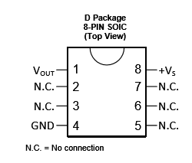
LM35
Pin Layout

Slide 13
Heart Rate sensor (TCRT1000)
It is a reflective optical sensor with infrared light emitter and phototransistor.
Pulling the enable pin high will turn the IR emitter LED on and activate the sensor.
Fingertip placed on the sensor will act as a reflector of the incident light.
The light reflected back from the fingertip is monitored by the phototransistor.
The output( V sensor )waveform is synchronous with heartbeat.

Slide 14
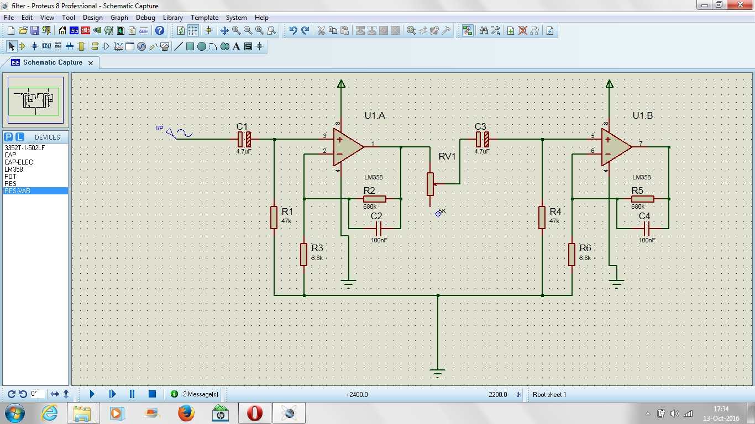
Circuit Diagram

Slide 15
In the circuit diagram, the sensor output is first passed through RC high-pass filter to remove the DC component.
Next stage is an active low pass filter to remove high frequency noise.
Thus the combination of both HPF and LPF amplifies the low amplitude pulse signal 101 times.
Thus it converts the input signals to pulses which are synchronous with heart beat.
The frequency(f) of these pulses are related to heart rate (BPM) as :
Beats per minute(BPM)=60*f

Slide 16
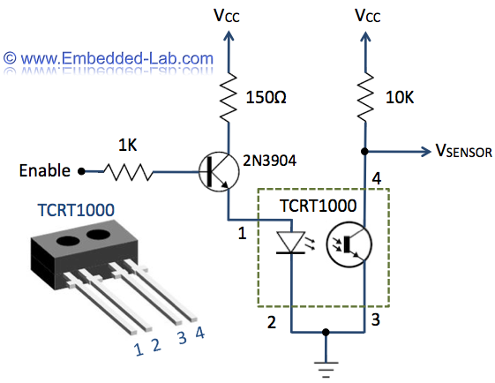
Pin diagram and
Internal circuitry

Slide 17
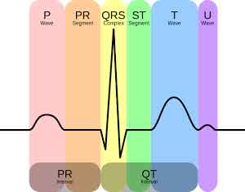
ECG sensor
It is used to measure electrical activity of the heart.
AD8232 is a signal conditioning block for ECG and other bio potential measurement applications.
ECG is separated into two basic intervals namely PR interval and QT interval.

Slide 18
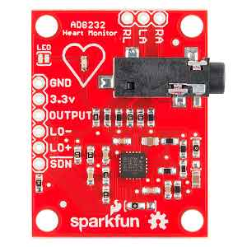
AD8232 has a operating voltage of 3.3v
This board is also provided with RA (right arm), LA(left arm), RL(right leg) pins attached.
There is also an LED indicator light that will pulsate to the rhythm of heart beat.
This board gives analog output.

Slide 19
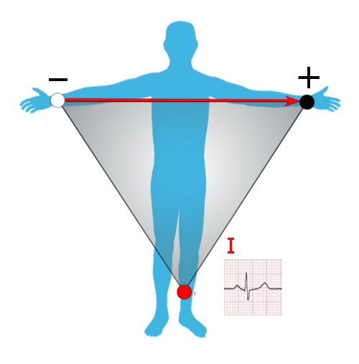
Fig: Placement of electrodes on to the human body

Slide 20
Working
The Microcontroller collects the data from the sensors and sends the data to the cloud using a web server.
The information is also sent to the LCD as well which is connected to microcontroller to display the vital parameters data.
The information containing vital parameters of patient is sent to the cloud.
Data can be accessed anytime by the doctors using unique IP Address and Password via any browser from any end devices such as laptop/mobile.

Slide 21
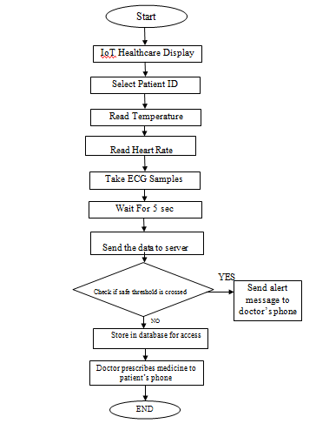
Flowchart

Slide 22
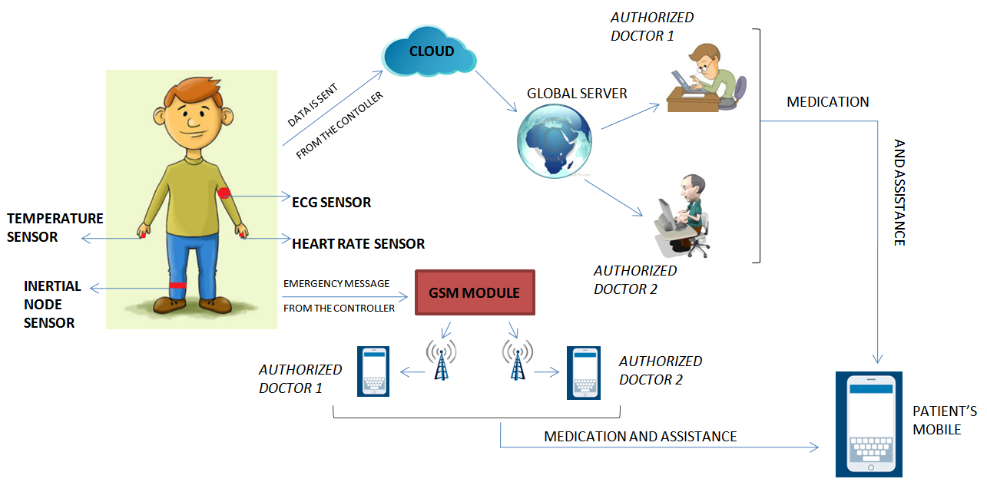
Schematic of proposed system

Slide 23
Conclusion
The current problems in healthcare system has been analyzed and a productive remote patient monitoring system is put forward which communicates through the internet to provide more desirable healthcare facilities.
The system is user friendly and in case of an emergency a warning message can be sent to the physician’s phone.
The doctors can view the patient’s parameters by logging to the web page with a unique ID and password.
Thus such a system will indeed be a boon for both doctors as well as patients.

Slide 24
Future scope
Integration with existing medical practices and technology.
Miniature wearable sensors.
Assistance to the elderly and chronic patients.
Patient tracking module can be included in the system using GPS.
A network on a diabetic patient could auto inject insulin though a pump, as soon as his insulin level declines, thus making the patient ‘doctor-free’ and virtually healthy.

Slide 25

Thank You

